Slide 1
Microsoft Teams Private Channel Architecture
Gayathri Nagamanickam
Senior Associate at Cognizant
@Gayathri_NU

Slide 2
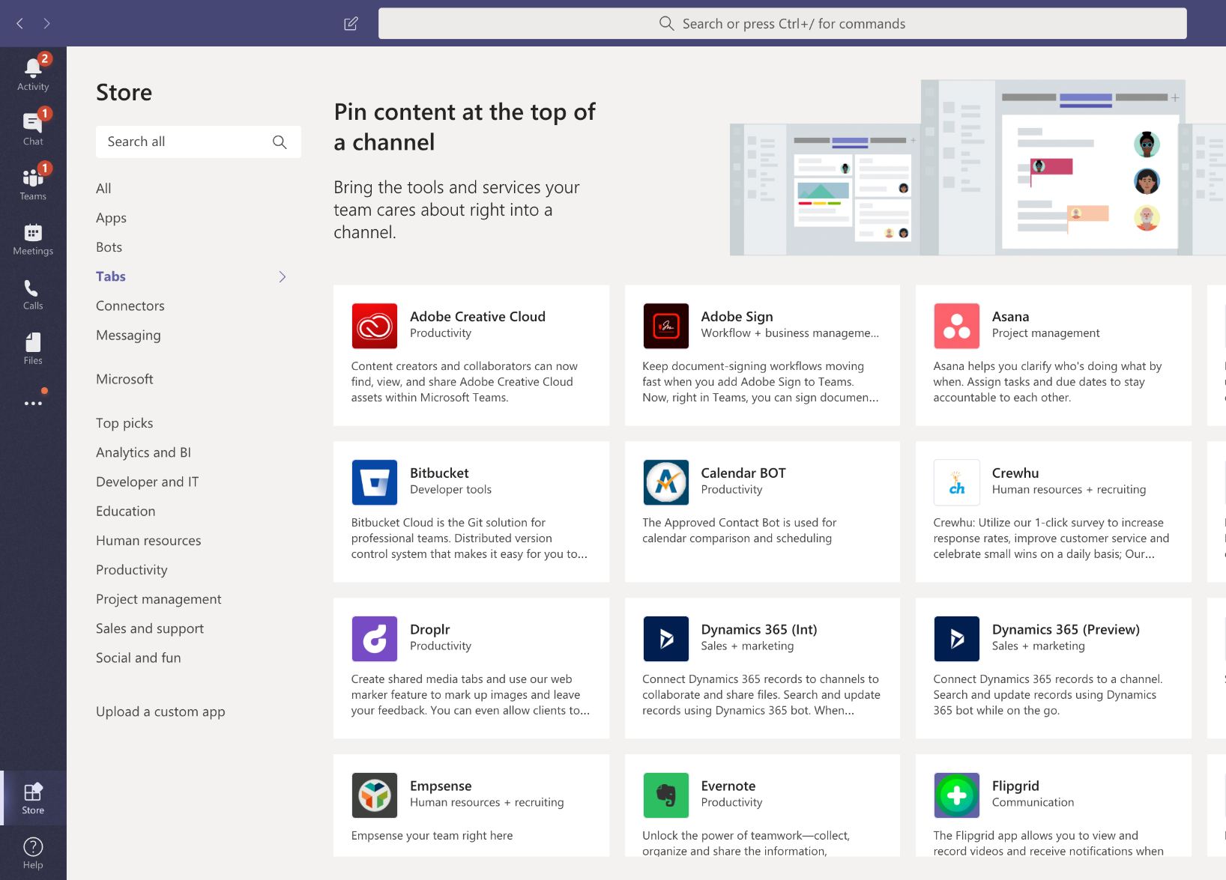
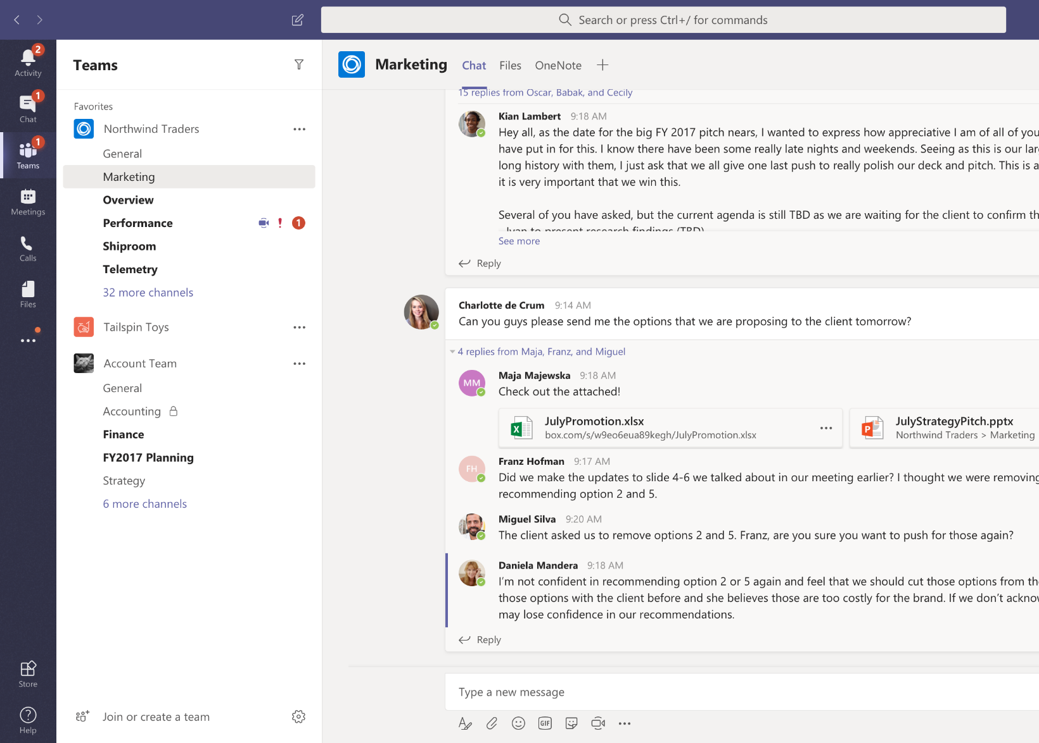
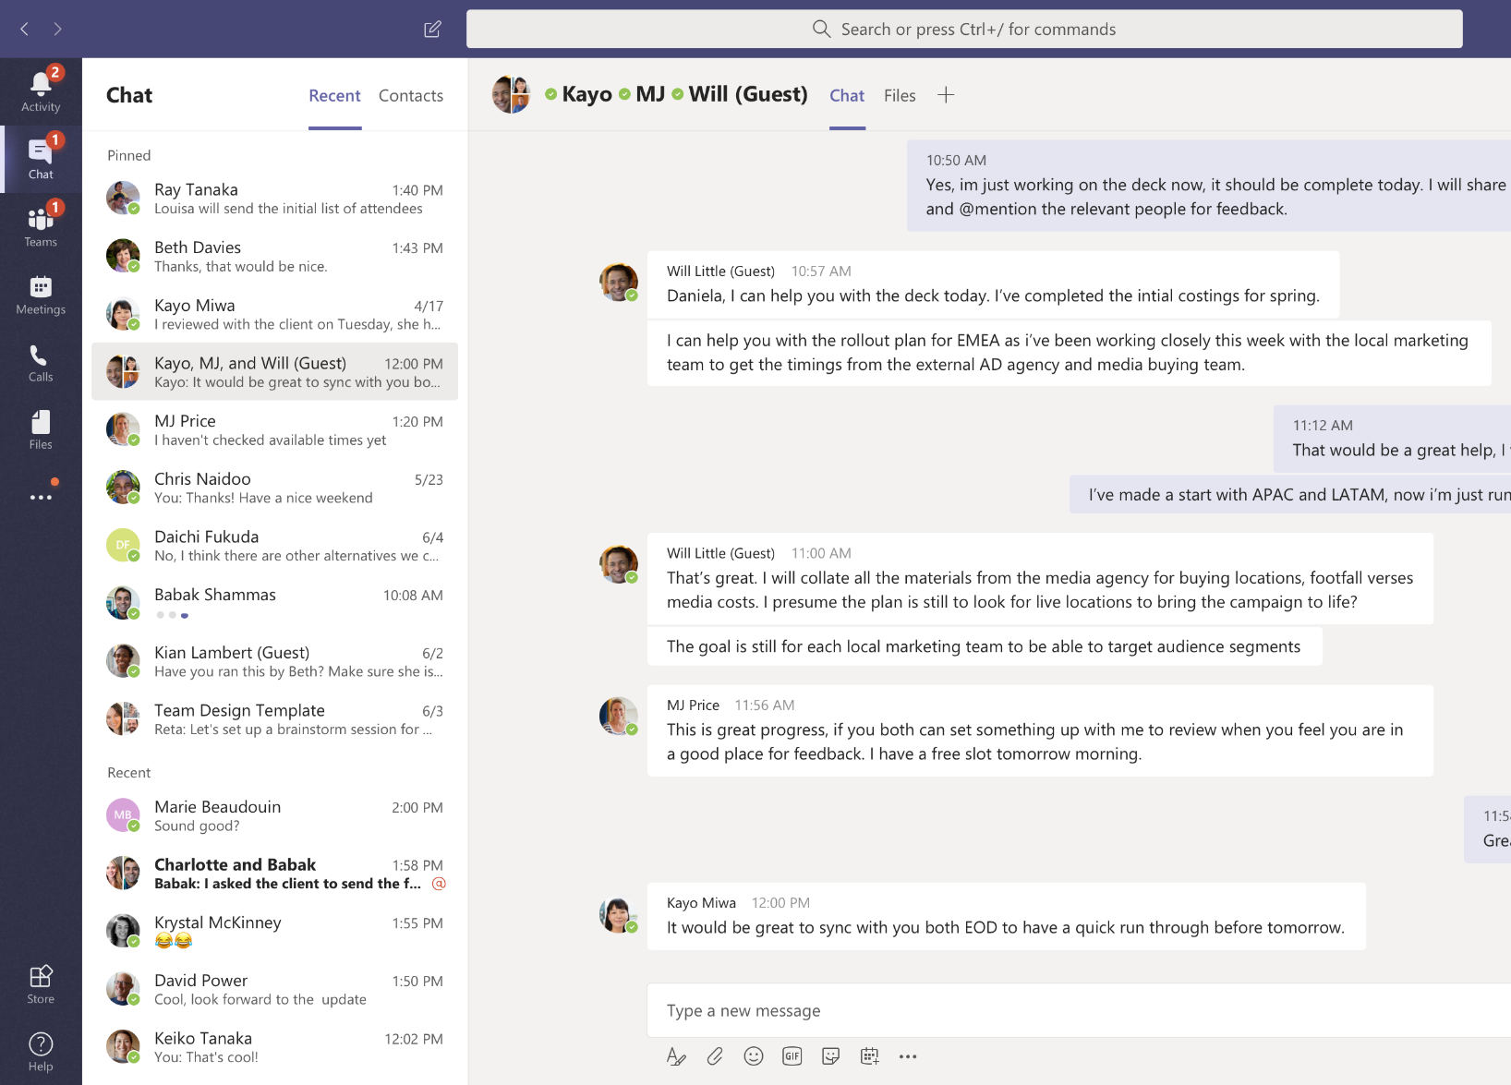
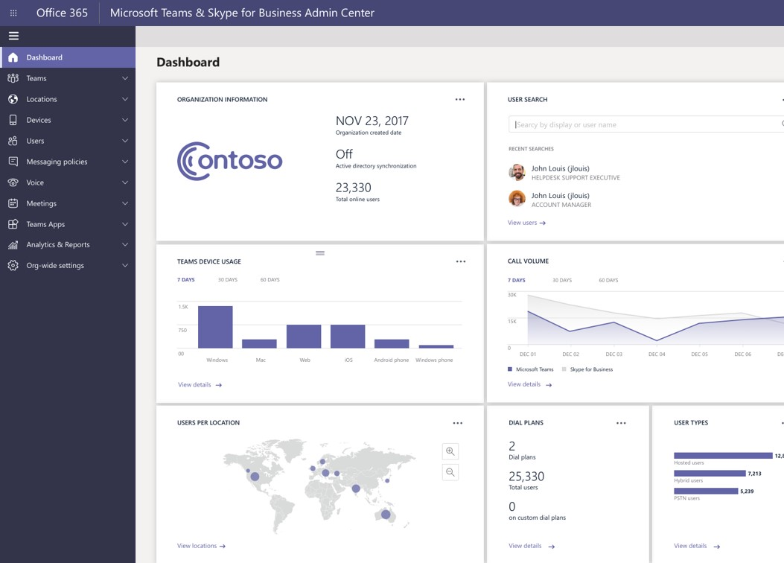






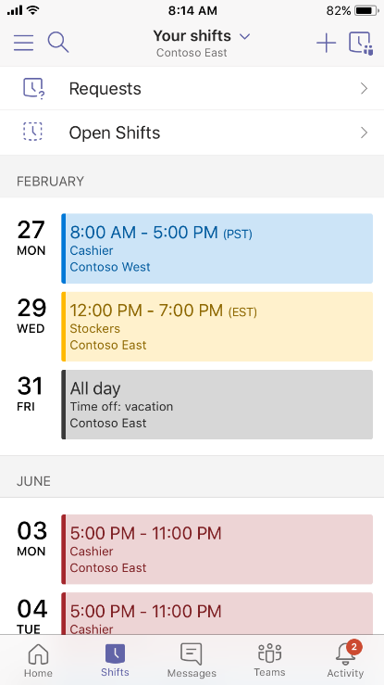
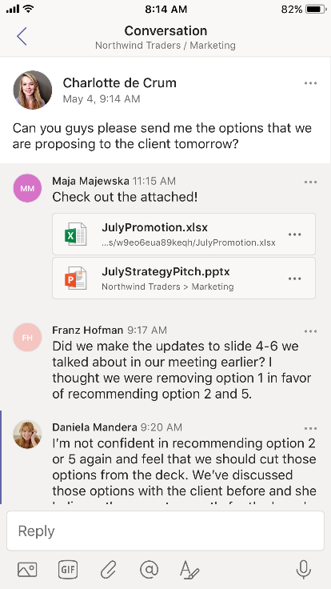
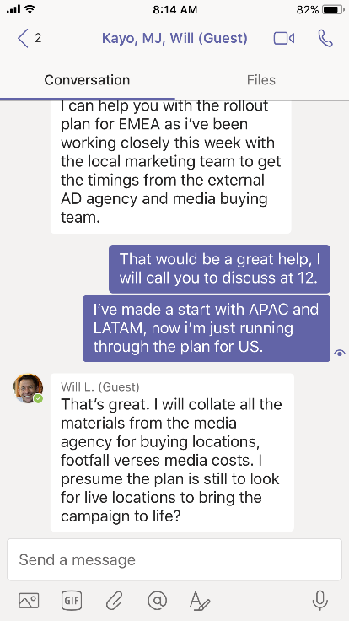
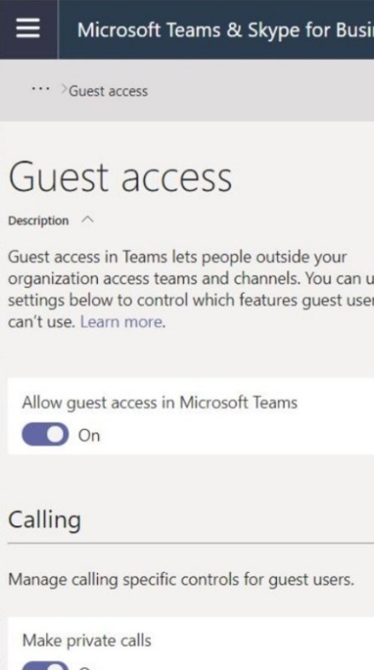





Microsoft Teams
The hub for teamwork in Microsoft 365
Communicate
through chat, meetings, and calls
Collaborate
with deeply integrated Office 365 apps
Customize and extend
with 3rd party apps, processes, and devices
Work with confidence
enterprise level security, compliance, and manageability
Notes:
[This is an animated slide. Please show it in presentation mode]
[MAIN POINT TO LAND]
Microsoft Teams is a hub for teamwork, a chat-based workspace that enables teams to be more productive by giving them a single and secure location that brings together everything a team needs: chats, meetings, calls, files, and tools. Microsoft Teams is one place for all the needs your teams have.
Microsoft Teams delivers on four core promises to create a digital workspace for high performing teams.
[COMMUNICATE]
First, Microsoft Teams solves for the communication needs of a diverse workforce.
Since preview, Microsoft Teams has evolved to a complete meetings and calling solution, incl. chat, voice and video, as we have completed our roadmap for bringing Skype for Business Online features and functionality into Teams. You can use Teams for informal 1:1 or group chats – directly on your phone if you’re on the go. Or you can have an open conversation in a channel. This enables people to share information in a transparent way to accelerate decision making. And it's super easy to move from a chat into a face to face meeting, helping you to bridge geographical barriers.
[COLLABORATE]
When it comes to collaboration, the deep Office integration enables today’s multigenerational workforce to use the Office apps they are familiar with and love - Word, Excel, PowerPoint, OneNote, SharePoint, Planner, even Power BI - right within the context of Teams.
You can avoid email attachments and having to search for the latest version of a document. Teams brings all the Office 365 services together – so that you can easily share and co-author files.
[CUSTOMIZE]
Many of you use other services than Office 365 as well which results in you having to jump between and spend time in disparate experiences. We built Teams to be the hub for all the services and tools your teams use on a day to day basis. So, you can customize Teams with tabs, connector and bots to include the apps and services you need - <mention relevant 3rd party apps like GitHub and Trello>. We have also created an extensible platform, to enable building apps and to integrate with business processes.
And for Firstline workers, Teams provides an additional set of capabilities including schedule management.
[WORK WITH CONFIDENCE]
Microsoft Teams comes with the enterprise grade security, compliance and manageability that you expect from Office 365 which customers tell us is a huge value add for them.

Slide 3

Private channels Focused private collaboration within a team
Teams
Creation
Admins can control via policies who can create private channels in tenant
Team owners can control via setting if members can create private channels
Limited to 30 private channels per team (in addition to 200 standard channels)
Membership
Private channel owners can add members and guests to a private channel
Only existing members and guests in the team can be added to a private channel
Only members of the private channel can view private channel content
Limited to 250 members per private channel
Standard
Channel
Private
Channel
Open collaboration within the team
Inherits full membership list from the team
Focused private collaboration within the team
Managed subset of members from team

Slide 4
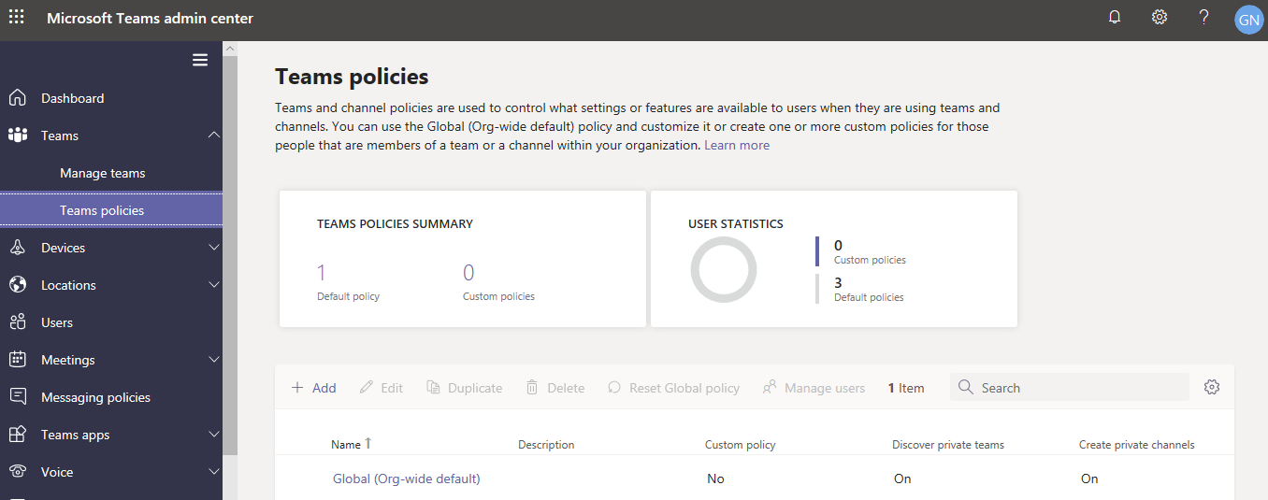
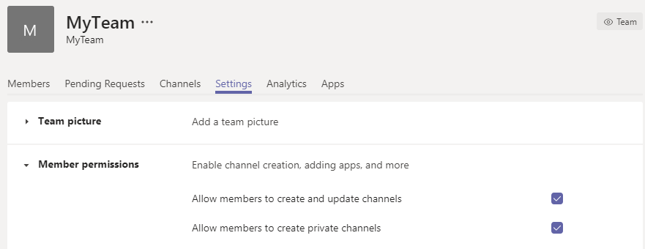
Private channels Focused private collaboration within a team
On the Settings tab for a team, team owners can turn off or turn on the ability for members to create private channels.
Manage teams policies by going to Teams > Teams policies in the Microsoft Teams admin center.

Slide 5
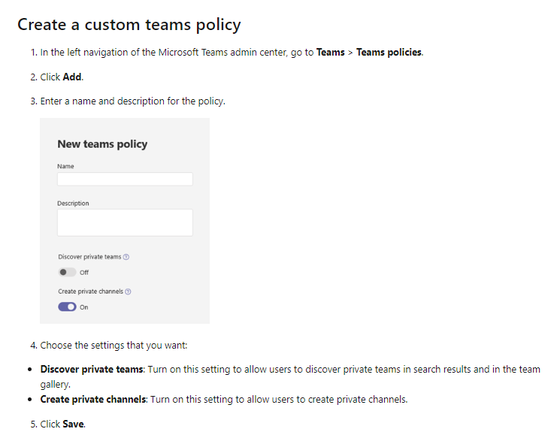
Private channels Focused private collaboration within a team
Use the global (Org-wide default) policy or create custom policies and assign them to users.
If a user is assigned a custom policy, that policy applies to the user.

Slide 6
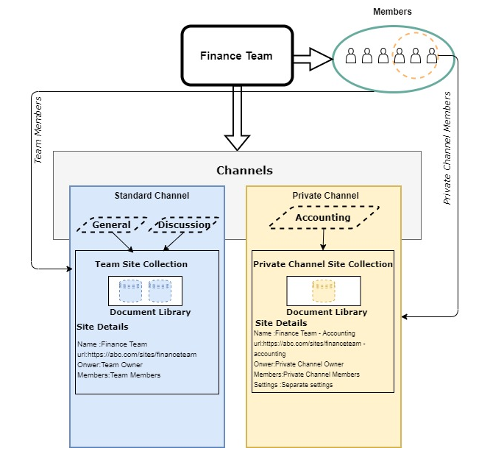
Private channel Architecture
Separate SharePoint Site Collection for each Private Channel.
Separate owner and team members for each Private Channel.
Site Collection owner and members are mapped to corresponding private channel owners and members.
Independ private channel settings does not depend on team settings.

Slide 7
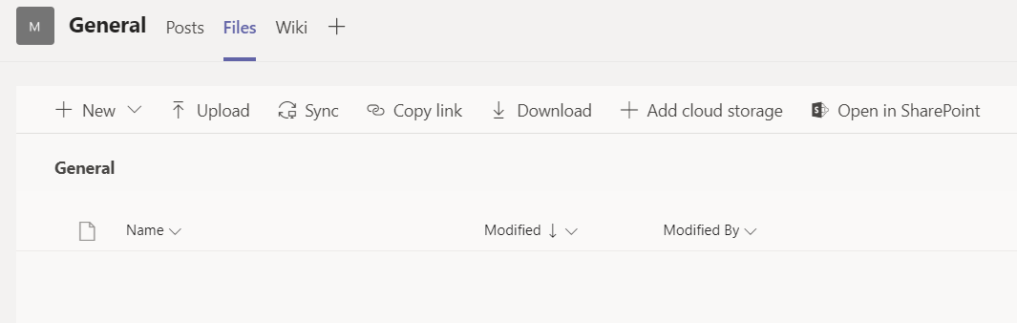
Teams and SharePoint Online
Files tab automatically created for every channel to point to folder in the group’s SharePoint site
Makes it easy for team members to store and access files in SharePoint
OneDrive for Business used for 1:1 and group chats

Slide 8
Team owners and private channels
Team owners can control if members can create private channels
Team owners can see names, last activity time and owners of all private channels in a team
Team owners can delete team or individual private channels without being a member
Removing a member from the team removes them from all private channels*
*Blocked from removing anyone who is the last owner of a private channel
Private channel information | Team owner can see | Team members can see
Name and description | All private channels in the team | Only when added to the private channel
Conversations and tabs | Only when added to the private channel | Only when added to the private channel
Files and content | Only when added to the private channel | Only when added to the private channel

Slide 9
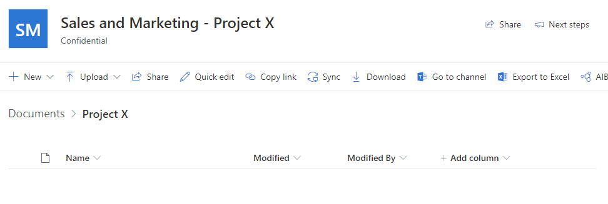
Files in private channels
Private channel files are stored in its own site collection
Ensures access to private channel documents is restricted to members
Site is named as <team name>-<channel name>
Comes with document library, lists can be added, pages not supported.
Lifecycle of the site collection is tied to private channel
Site collection created in the same geo as team, inherits guest permission on create
Membership and data classification of the site collection is kept in sync with team
Site collections per tenant limit has been enhanced from 500K to 2M

Slide 10
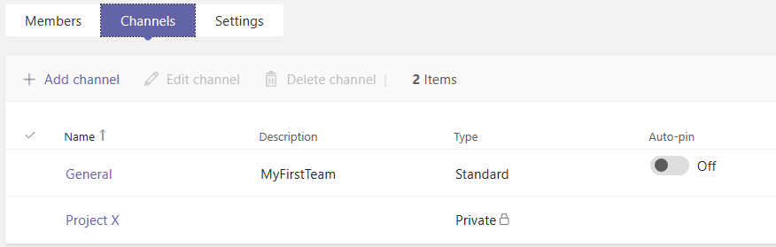
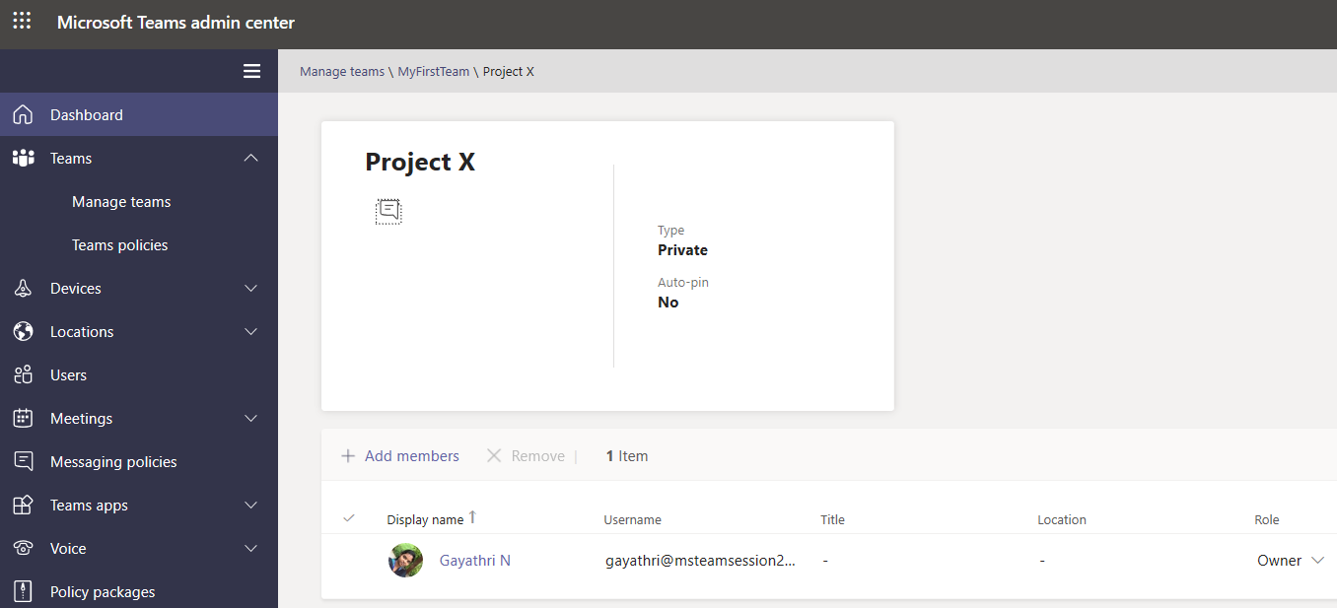
Administration
All teams and channels, including private channels, can be managed from the Teams admin portal
Create or delete private channels
Edit channel name & description
Add or remove members
Promote or demote members and owners
PowerShell & Graph API support

Slide 11
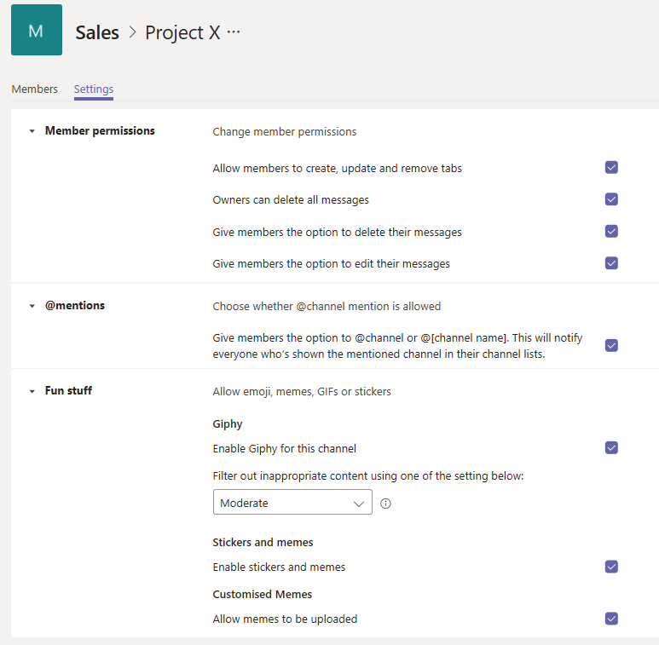
Channel owners and settings
Private channels owners manage the membership and life cycle of private channels
Last owner of a private channel cannot be removed from the team
If a private channel becomes ownerless (user leaves company), an existing non-guest member is auto-promoted to owner
Private channels inherit settings from the team on create
Settings can be changed at channel level

Slide 12
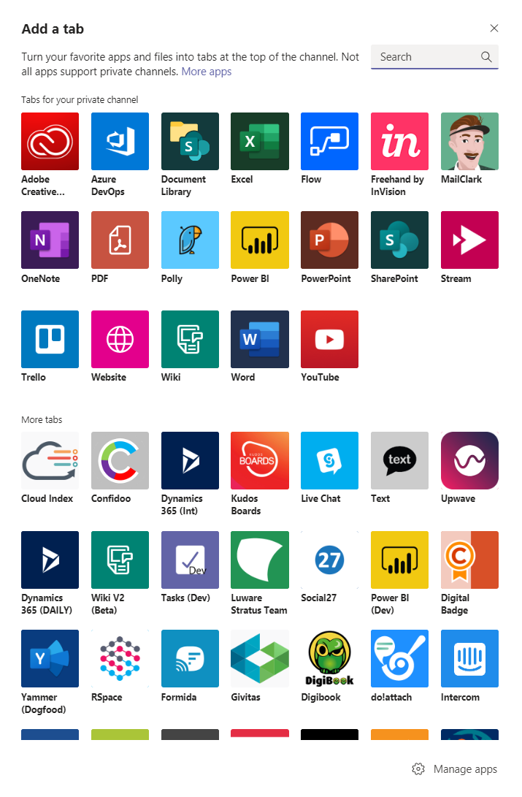
Apps in private channels
Tabs and connectors supported
Apps must be installed in the team before they can be used in a private channel
Bots and message extension support coming later
Support for certain Office 365 group connected apps like Planner coming later

Slide 13
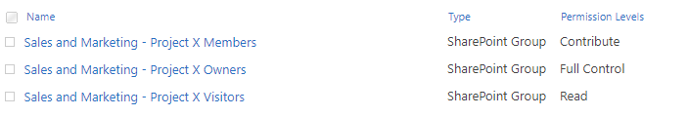
Site management
Management via PowerShell
Filter by template “TeamChannel#0”
Sites hidden in the SharePoint admin center
Owner and member groups managed by Teams
Any direct changes to these groups in SP will be synchronized with the private channel owner and members list
Use visitor or a new group if you need to grant users access to documents and not channel conversations
Get all sites backing private channels in tenant
Get-SPOSite -Limit ALL -Template "TEAMCHANNEL#0"
Default site membership groups and permissions

Slide 14
PowerShell & Graph API
Channel creation
Graph API | PowerShell Commands
POST /teams/{id} GET /teams/{id}/channels PATCH /teams/{id}/channels/{id} DELETE /teams/{id}/channels/{id} | New-TeamChannel Get-TeamChannel Set-TeamChannel Remove-TeamChannel
Channel membership
Graph API | PowerShell Commands
POST /teams/{id}/channels/{id}/members GET /teams/{id}/channels/{id}/members PATCH /teams/{id}/channels/{id}/members DELETE /teams/{id}/channels/{id}/members | Add-TeamChannelUser Get-TeamChannelUser Remove-TeamChannelUser

Slide 15
Team Lifecycle
Create a team
Add members and owners
Configure team settings
Add channels
Archive or delete the team when the time comes
Install apps
Add tabs
Send messages

Slide 16
Teams PowerShell Module
To Install Standard teams module type the following cmdlet in PowerShell.
Install-Module -Name MicrosoftTeams
This installs standard publicly available version of PowerShell which doesn’t support creation of Private channels.
To work with private channels, register the PowerShell gallery as trusted source.
Register-PSRepository -Name PSGalleryInt -SourceLocation https://www.poshtestgallery.com/ -InstallationPolicy Trusted
Run the following command
Install-Module -Name MicrosoftTeams -Repository PSGalleryInt –Force
To get the commands of Microsoft Teams module run the following cmdlet.
Get-Command -Module MicrosoftTeams

Slide 17
Teams cmdlets
Example
Connect-MicrosoftTeams -AccountId gayathri@SPSChennai2020.onmicrosoft.com
$group = New-Team -MailNickname “Project Team" -displayname “Project Team" -Visibility "private"
Add-TeamUser -GroupId $group.GroupId -User “surya@SPSChennai2020.onmicrosoft.com"
New-TeamChannel -GroupId $group.GroupId -DisplayName “Development"
New-TeamChannel -GroupId $group.GroupId -DisplayName “Testing “
Add-TeamChannelUser -GroupId $group.GroupId -DisplayName " Resource Planning " -User “pradeep@SPSChennai2020.onmicrosoft.com "

Slide 18


Slide 19


Sponsors

Slide 20
Microsoft Team Private Channel Architecture
Gayathri Nagamanickam

